Slide 1

Security Lab04
Harry Bebbington

Slide 2
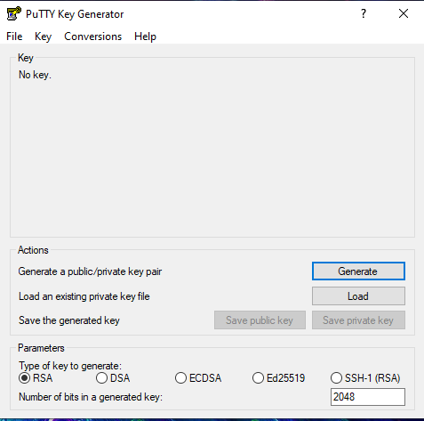
Part(A)
Generated using Putty Gen
Public key and private key generated

Slide 3
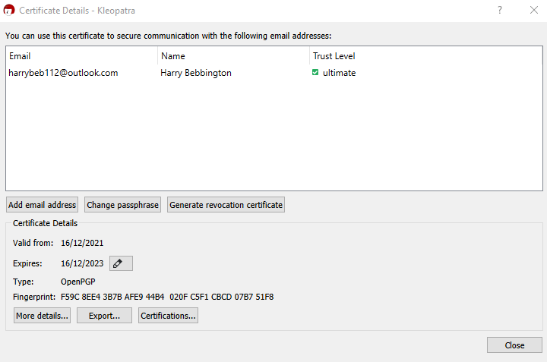
Part B
Email encryption with cleopatra
We generate a key pair within cleopatra, create a note and then encrypt and sign it with the certificate.

Slide 4
Part C
In this section I present a report that summarise a vulnerabilities for systems clocks that allow for attacks.
Attacks summarised:
Network time protocol(NTP)
KoD(key on Demand) mechanism attack

Slide 5
Part D
The RSA algorithm is used by modern computers to encrypt and decrypt messages.
It is an asymmetric cryptographic algorithm(Two different keys).
Comprised of a public and a private key.
The algorithm is dependent on the fact that finding factors of outsized numbers is difficult.

Slide 6
Part D
RSA Algorithm Used
Consider two prime numbers p and q.
Compute n = p*q
Compute ϕ(n) = (p – 1) * (q – 1)
Choose e such gcd(e , ϕ(n) ) = 1
Calculate d such e*d maod ϕ(n) = 1
Public Key {e,n} Private Key {d,n}
Cipher text C = Pe mod n where P = plaintext
For Decryption D = Dd mod n where D will refund the plaintext.

Slide 7

Sample output
First prime is : 5
Second Prime is: 11

